Slide 1

Project Presentation on Multiplying Huge Integers using Fourier Transform
By:
Anik Goyal
M.Tech, IISc Bangalore

Slide 2
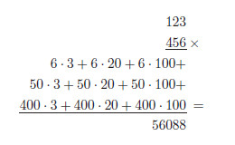
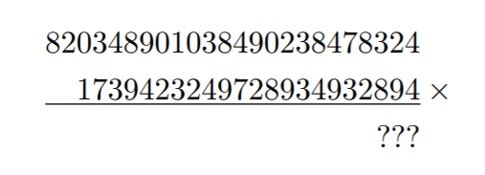

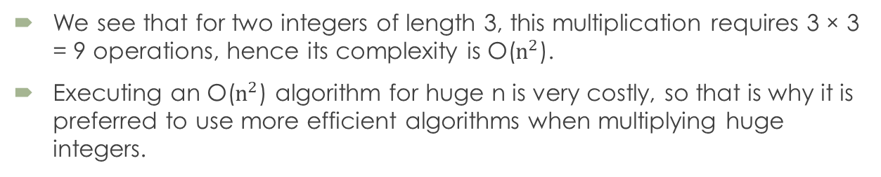
Problem Statement
The problem is that traditional approaches to multiplication requires O($n^{2}$) multiplication operations, where n is the number of digits.
To see why, assume for example that we want to multiply the numbers 123 and 456. The normal way to do this as follows:
What about this one?
Conventional Multiplication
We see that for two integers of length 3, this multiplication requires 3 × 3 = 9 operations, hence its complexity is O($n^{2}$).
Executing an O($n^{2}$) algorithm for huge n is very costly, so that is why it is preferred to use more efficient algorithms when multiplying huge integers.
One way to do this more efficiently in O(nlogn), is by using FFT

Slide 3

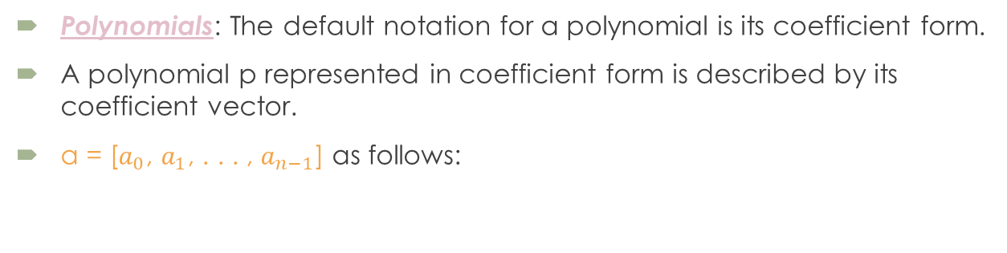
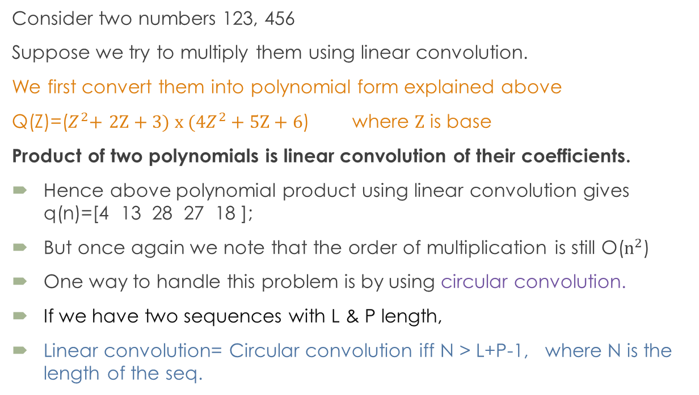
How does FFT multiplication works?
Polynomials: The default notation for a polynomial is its coefficient form.
A polynomial p represented in coefficient form is described by its coefficient vector.
a = [$a_{0}$, $a_{1}$, . . . , $a_{n−1}$] as follows:
Consider two numbers 123, 456
Suppose we try to multiply them using linear convolution.
We first convert them into polynomial form explained above
Q(Z)=($Z^{2}$+ 2Z + 3) x (${4Z}^{2}$+ 5Z + 6) where Z is base
Product of two polynomials is linear convolution of their coefficients.
Hence above polynomial product using linear convolution gives q(n)=[4 13 28 27 18 ];
But once again we note that the order of multiplication is still O($n^{2}$)
One way to handle this problem is by using circular convolution.
If we have two sequences with L & P length,
Linear convolution= Circular convolution iff N > L+P-1, where N is the length of the seq.

Slide 4
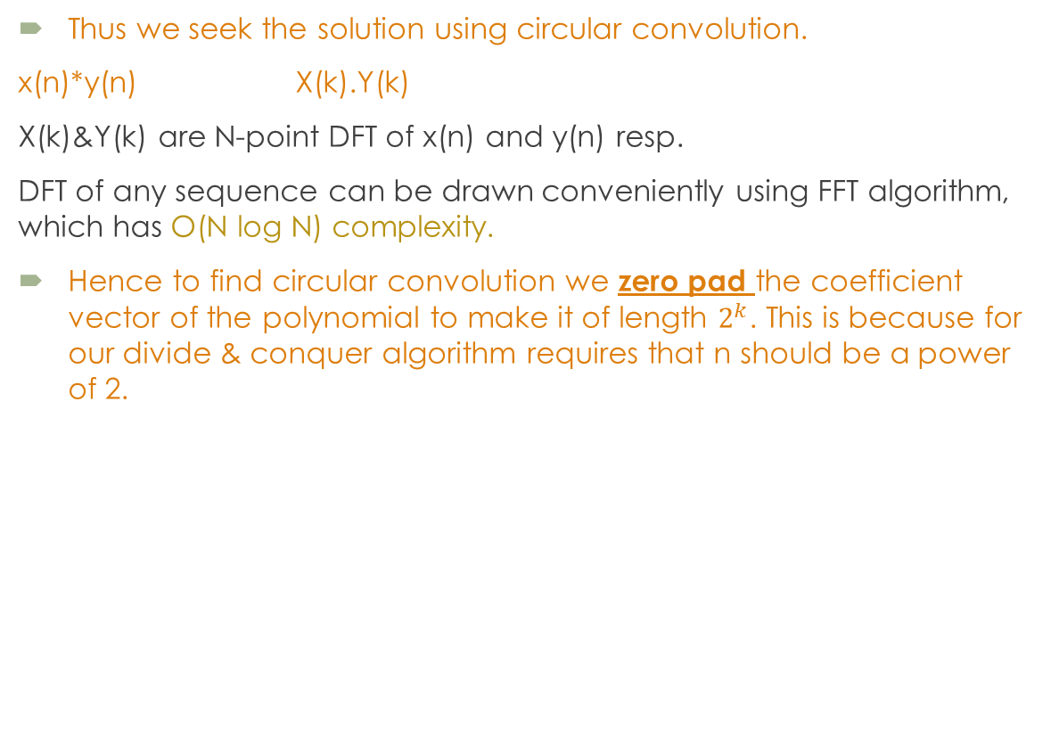
How does FFT multiplication works?
Thus we seek the solution using circular convolution.
x(n)*y(n) X(k).Y(k)
X(k)&Y(k) are N-point DFT of x(n) and y(n) resp.
DFT of any sequence can be drawn conveniently using FFT algorithm, which has O(N log N) complexity.
Hence to find circular convolution we zero pad the coefficient vector of the polynomial to make it of length $2^{k}$. This is because for our divide & conquer algorithm requires that n should be a power of 2.

Slide 5
Cooley-Tukey algorithm for FFT
Special Properties of primitive nth root of unity:
The reflective property: If ω is a primitive nth root of unity and n ≥ 2 is even, then ω^{k+n/2}= - ω^{k}
The reduction property: If ω is a primitive 2n^{th} root of unity, then ω² is a primitive n^{th} root of unity.
Divide and conquer approach:
The elegance of the Cooley-Tukey algorithm lies its divide-&-conquer nature
If n is even we can divide n-1 degree polynomial into 2 parts:
p (x)= a₀ + a₁x+ a₂x²+ …+a_{n-1}x^{n-1}
p_{even} (x)= a₀ + a₂x+ a₄x²+ …+a_{n-2}x^{n/2-1}
p_{odd} (x)= a₁ + a₃x+ a₅x²+ …+a_{n-1}x^{n/2-1}
which we can combine into p using the equation
p(x)= p_{even} (x²) + x p_{odd} (x²)

Slide 6
Cooley-Tukey algorithm for FFT
So by these recursive calls, we now have the values for p even and p odd, evaluated at all the n/2 powers of ω². Since we know by reduction property that all n/2 powers of ω² are a subset of the powers of the n powers of ω , and to be more specific,
we know that they match exactly half the values of the n powers of ω;
we can combine their results which will give us evaluations of p for half the values in the set of n powers of ω. The other half, we can derive from these values by using the reflective property.
This idea is formalized in equation:
p(ω^{k}) = p_{even} (ω^{2k}) + ω^{k} p_{odd} (ω^{2k}) p(ω^{k+n/2}) = p_{even} (ω^{2k}) - ω^{k} p_{odd} (ω^{2k})
The complexity of this algorithm is O(n log(n)).

Slide 7
Pseudo Code
def FFT(f):
n = len(f)
if n==1: return [f[0]]
F = n*[0]
f_even = f[0: :2] {even indexed terms}
f_odd = f[1: :2] {odd indexed terms}
F_even = FFT(f_even)
F_odd = FFT(f_odd)
n2 = int(n/2)
for i in range(n2):
twiddle = np.exp(-2*np.pi*j*i/n) {generating the twiddle factor}
oddTerm = F_odd[i] * twiddle
F[i] = F_even[i] + oddTerm
F[i+n2] = F_even[i] - oddTerm

Slide 8
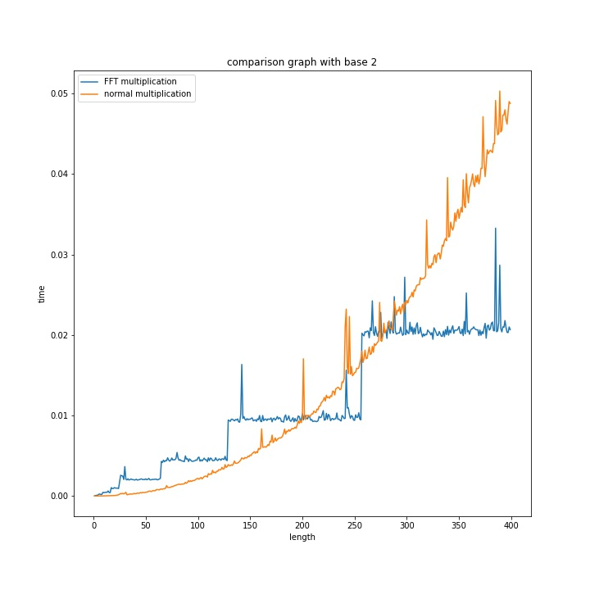
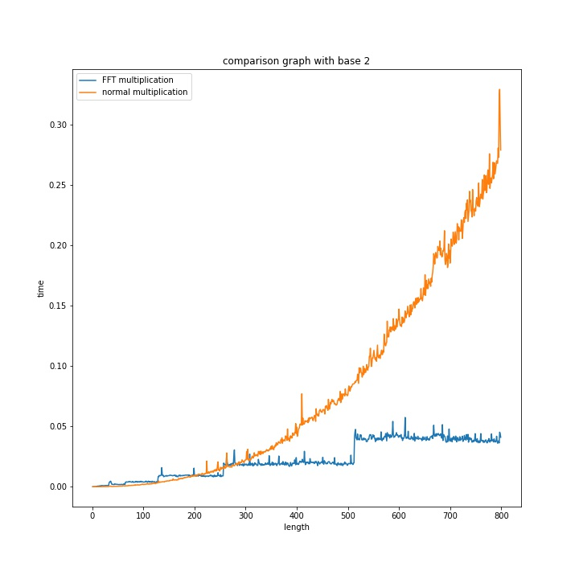
Results
Base 2

Slide 9
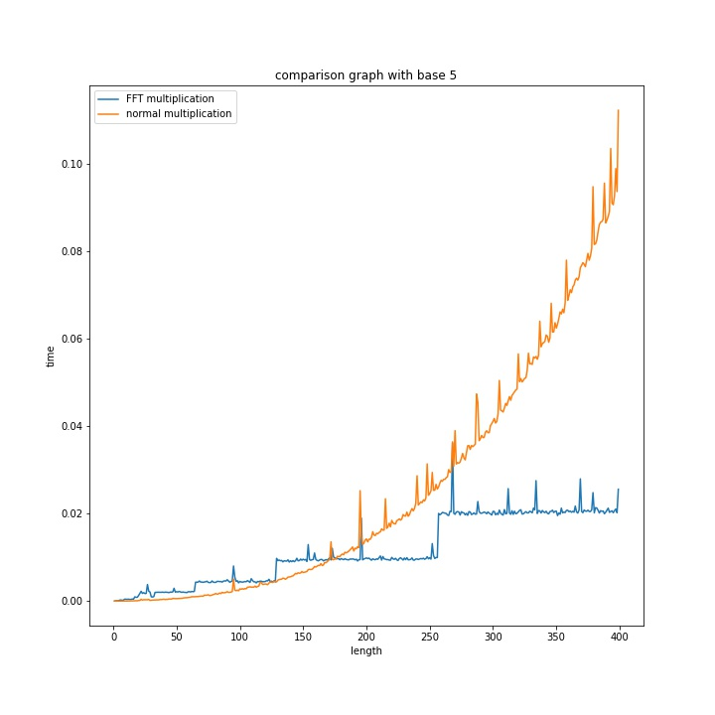
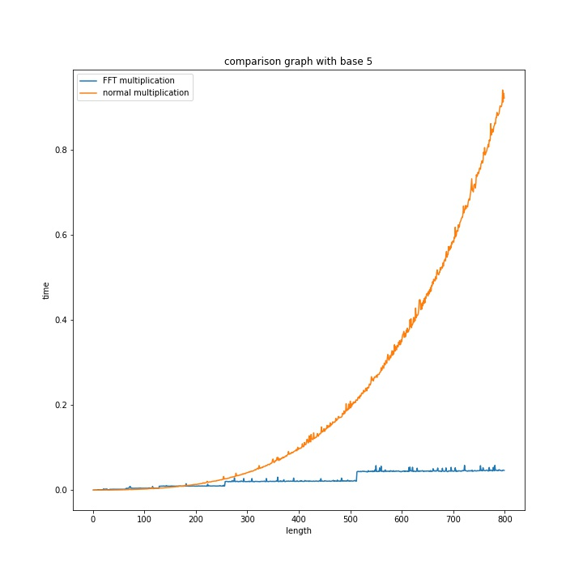
Results
Base 5

Slide 10
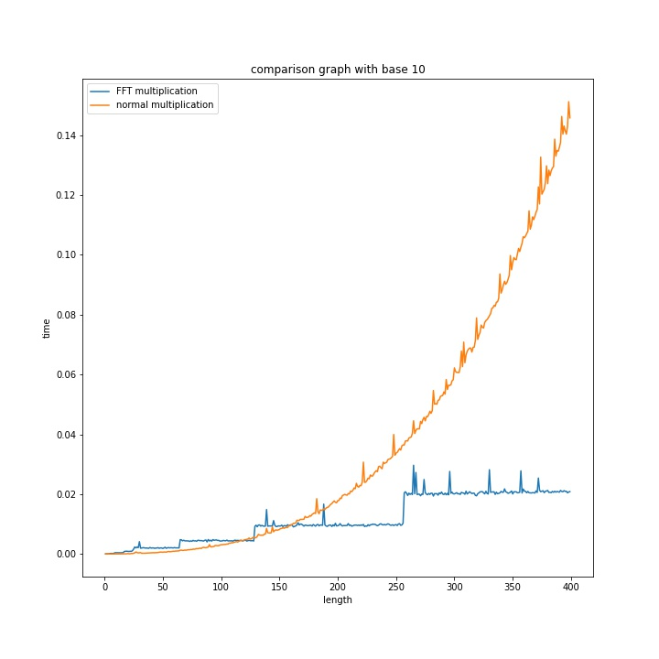
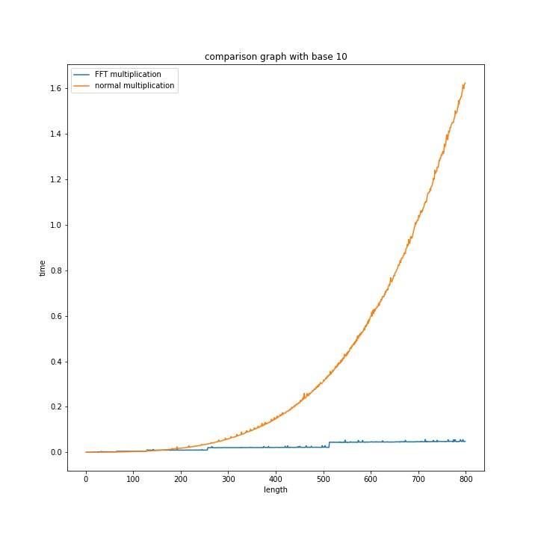
Results
Base 10

Slide 11
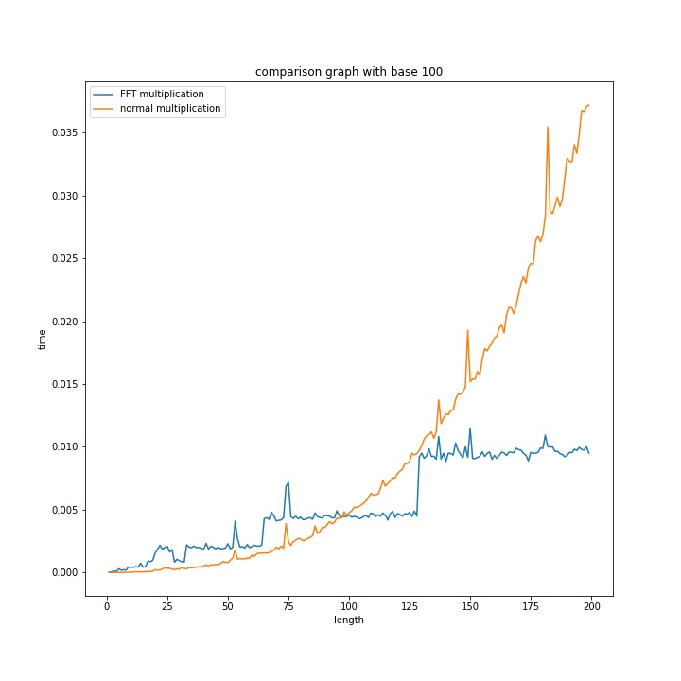
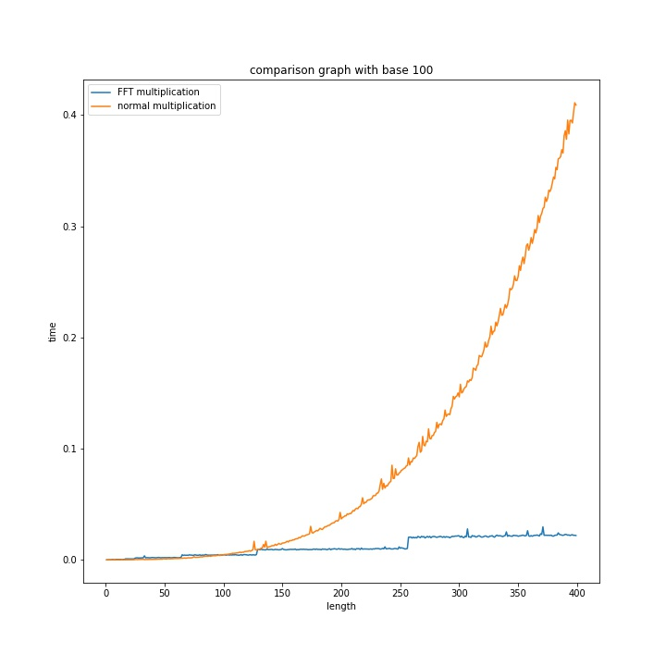
Results
Base 100

Slide 12
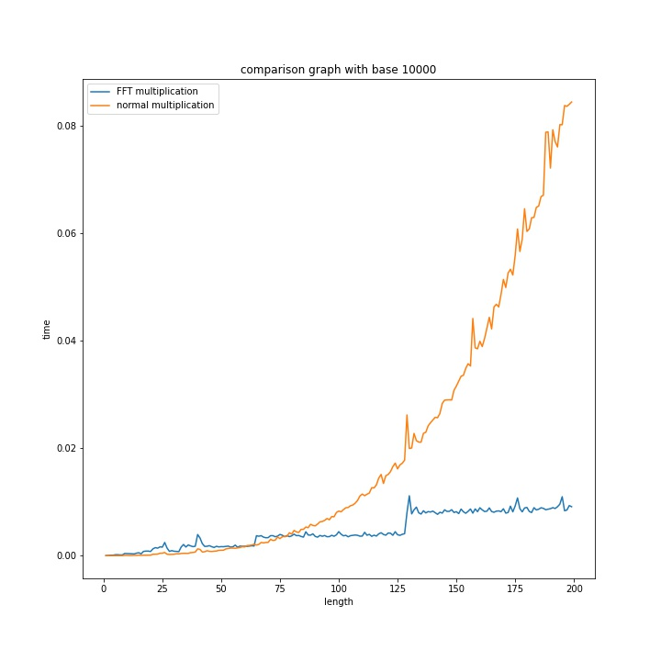
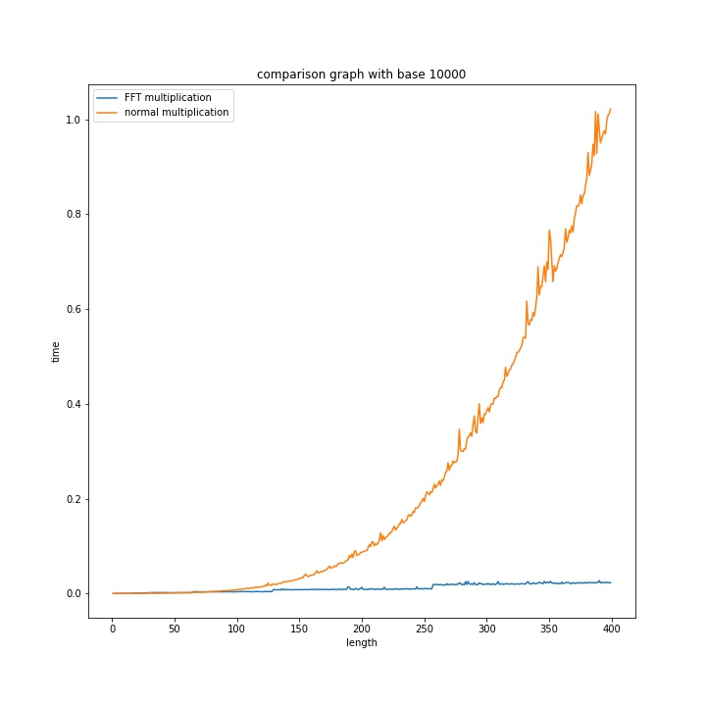
Results
Base 10000

Slide 13
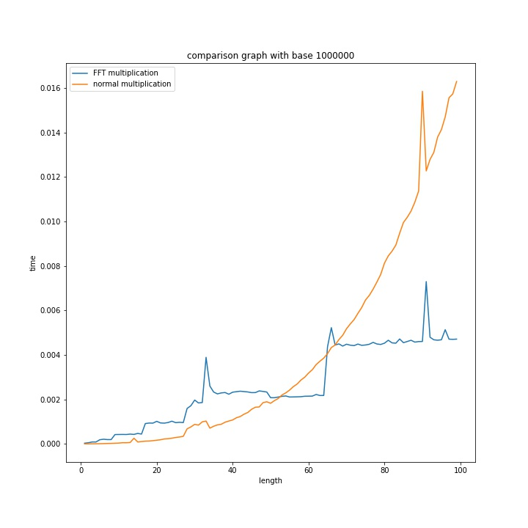
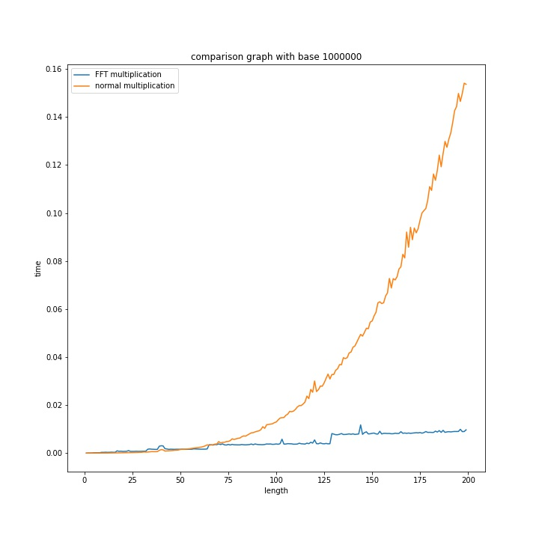
Results
Base 100000

Slide 14
Conclusion
FFT multiplication will become faster than normal multiplication at some point.
Choosing a larger base will speed up the calculation of both the normal and FFT multiplication.
For number lengths of around 10000 and higher (depending on the base used), FFT multiplication can easily be more than 100 times as fast as a normal multiplication implementation.
When working with numbers of 10 raise to the power 7 or higher, we may have to choose a smaller base in order to avoid rounding errors from causing an incorrect answer.
Choosing a larger base will increase the maximum square error of IFFT.

Slide 15
Thankyou

Slide 16
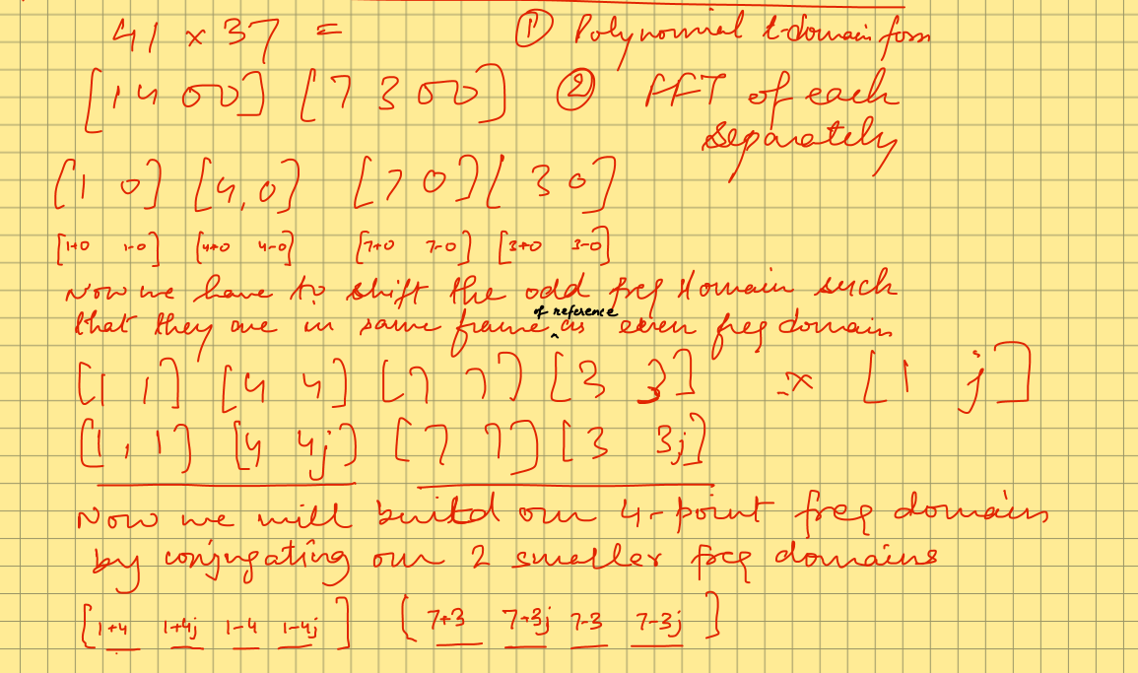
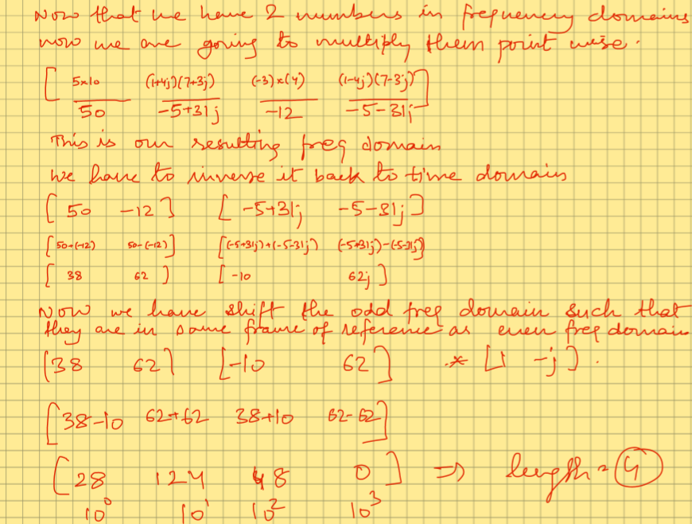
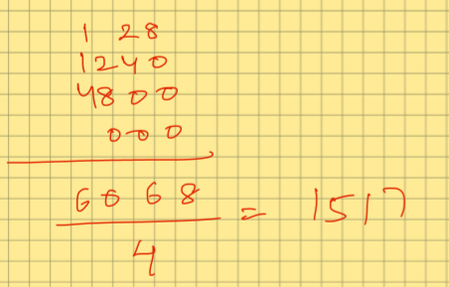
Backup
1
2
3

